Slide 1
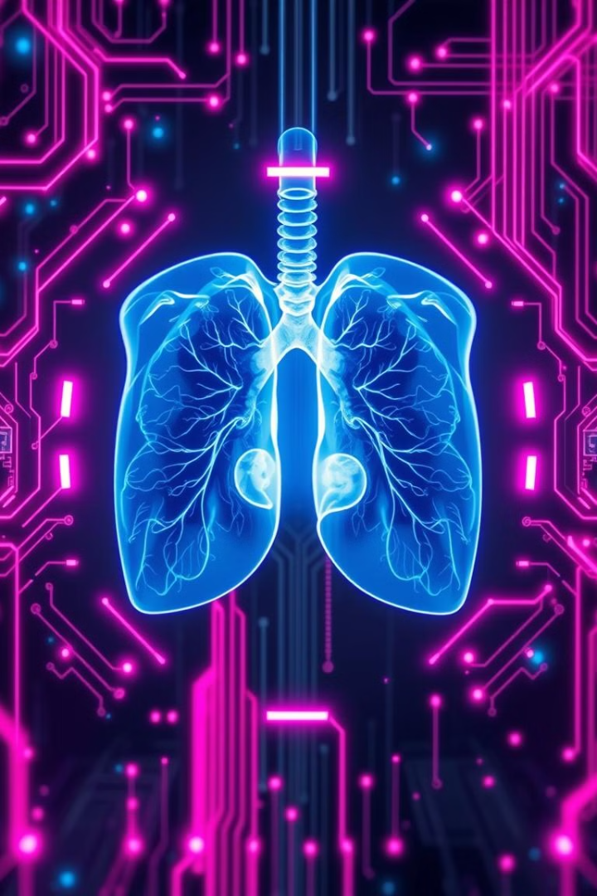
Pneumonia Detection Using Deep Learning (VGG16)
Hackathon Project Presentation
Team Members: Doondi Bala Saraswathi - 2320040050 DVNSL Praharshitha- 2320040059
Date: 6th March2025

Slide 2
Abstract & Introduction: The Critical Need
Pneumonia: A leading cause of mortality worldwide, especially in children under 5 (WHO data).
Problem Statement: Manual diagnosis via X-ray is time-consuming and prone to human error.
Project Goal: Develop an accurate and efficient pneumonia detection system using deep learning to assist radiologists and improve patient outcomes.
Deep Learning Justification: Convolutional Neural Networks (CNNs) have shown superior performance in image recognition tasks compared to traditional methods. (Cite: Relevant research paper comparing DL to traditional methods, if possible).
Manual diagnosis is prone to error.
Deep learning can improve accuracy.

Slide 3
Proposed Approach: VGG16 - A Powerful CNN Architecture
Architecture Choice: VGG16, pre-trained on ImageNet, known for its robustness and transfer learning capabilities (Cite: Original VGG16 paper).
Key VGG16 features: 13 convolutional layers, 5 pooling layers, and fully connected layers for classification.
Transfer Learning: Leverage VGG16's pre-trained weights to accelerate training and improve accuracy on our specific pneumonia detection task.
Rationale: Reduces training time and data requirements compared to training a CNN from scratch.
1
VGG16 is a powerful architecture.
2
It's pre-trained on a large dataset.
3
Transfer learning speeds up training.

Slide 4
Data Preprocessing & Augmentation: Preparing for Optimal Performance
Dataset: Chest X-ray images from [Source of dataset - e.g., NIH Chest X-ray Dataset, Kaggle].
Data Split: Training set (70%), Validation set (15%), Testing set (15%). Mention the number of images in each set.
Preprocessing Steps:
Rescaling: Pixel values normalized to the range [0, 1].
Data Augmentation: Apply random rotations (up to 20 degrees), width/height shifts (up to 10%), shear (up to 0.2), zoom (up to 0.2), and horizontal flips to increase dataset size and model robustness. Example: Increase dataset by 3x using augmentation.
Justification: Augmentation reduces overfitting and improves generalization to unseen X-ray images.
Rescaling normalizes pixel values.
Augmentation increases dataset size.
Data quality is essential for training.

Slide 5




Model Training & Fine-Tuning: Optimizing for Pneumonia Detection
Fine-Tuning Strategy: Unfreeze last few convolutional blocks of VGG16 and train them along with the classifier layers.
Optimizer: Adam optimizer with a learning rate of [e.g., 0.0001].
Loss Function: Binary Cross-Entropy Loss (suitable for binary classification: Pneumonia vs. No Pneumonia).
Training Details: Number of epochs [e.g., 10-20], batch size [e.g., 32].
Early Stopping: Monitor validation loss to prevent overfitting and stop training when validation loss plateaus.
Fine-tune the model.
Optimize the learning rate.
Train for multiple epochs.
Implement early stopping.

Slide 6




Results & Evaluation: Quantitative Performance Metrics
Performance Metrics:
Accuracy: [e.g., 92%] - Percentage of correctly classified images.
Precision: [e.g., 95%] - Ability to correctly identify pneumonia cases (minimize false positives).
Recall: [e.g., 90%] - Ability to detect all actual pneumonia cases (minimize false negatives).
F1-Score: [e.g., 92.4%] - Harmonic mean of precision and recall.
Confusion Matrix: Visualize true positives, true negatives, false positives, and false negatives.
ROC Curve & AUC: Area Under the Curve (AUC) of [e.g., 0.96] indicates excellent discriminatory power.
Comparison: Compare the performance of our model with existing state-of-the-art methods for pneumonia detection (cite a research paper and add metrics)
1
2
Accuracy.
Precision.
F1-Score.
Recall.
4
3

Slide 7
Discussion & Challenges: Insights and Roadblocks
Key Findings: VGG16, fine-tuned on chest X-ray images, achieves high accuracy in pneumonia detection.
Challenges Faced:
Limited dataset size and class imbalance (more "No Pneumonia" cases).
Variability in X-ray image quality and patient positioning.
Generalizability to diverse patient populations and imaging protocols.
Solutions Implemented: Data augmentation, class weighting during training.
Potential Improvements:
Explore other CNN architectures (e.g., ResNet, DenseNet).
Incorporate clinical data (e.g., patient age, symptoms) for improved diagnosis.
Use larger and more diverse datasets for training.
Challenges.
1
2
Solutions.
Future work.
3

Slide 8
Conclusion & Future Work: Impact and Next Steps
Summary: Developed a pneumonia detection system using VGG16 with promising results.
Potential Impact: Assist radiologists in making faster and more accurate diagnoses, leading to improved patient care and outcomes.
Future Directions:
Deploy the model in a real-world clinical setting for evaluation.
Develop a user-friendly interface for easy access and interpretation.
Explore methods for explainable AI (XAI) to understand the model's decision-making process.
Thank You & Q&A
Explore explainable AI.
Develop an interface.
Deploy the model.

Slide 9
THANK YOU

